Slide 1

אדיר כהן אילזרוב-207058355
Known Bug - Only crooked hands
All Done !

Slide 2

Install instruction
npm install
Open three terminals in parallel
First terminal: node .\p2p-full-nodes.js 4001 4002 4003
Second terminal: node .\p2p-wallet.js 4002 4003 4001
Third terminal: node .\p2p-wallet.js 4003 4002 4001

Slide 3
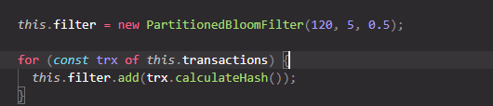
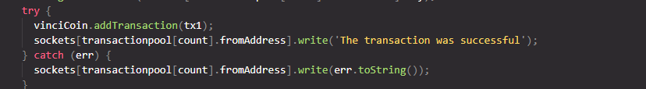
a)
There is a BloomFilter in every block
b)
Each transaction is saved in a MerkleTree in a block
c)
If the transaction is successful, we will send successful if not, we send error to the right peer

Slide 4
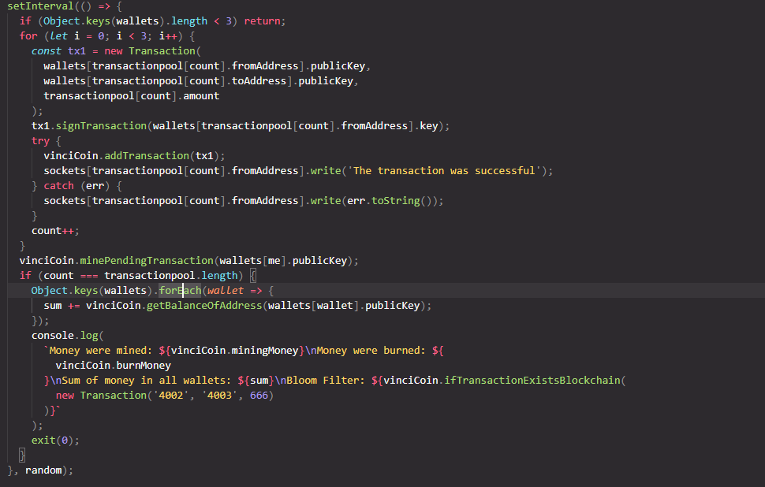
d+g)
We read all transactions from the file and conduct transactions

Slide 5
e)
in addition there is a mining transaction
f)
-1 is the reward for the miner

